Slide 1
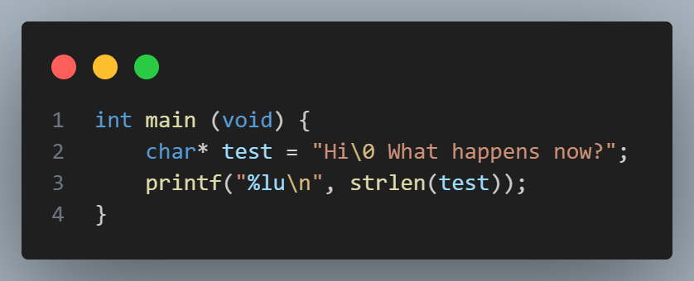
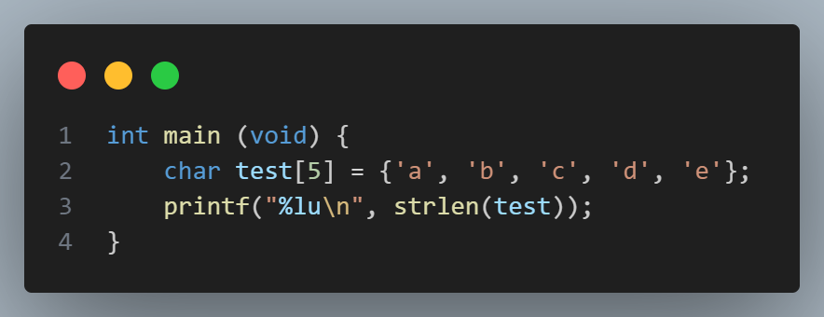
Questions before we start!
1) How might you have used arrays in PSET 1? Discuss with a partner.
2) What do you think this prints? Try it!
3) What do you think this prints? Try it!
Puzzles

Slide 2
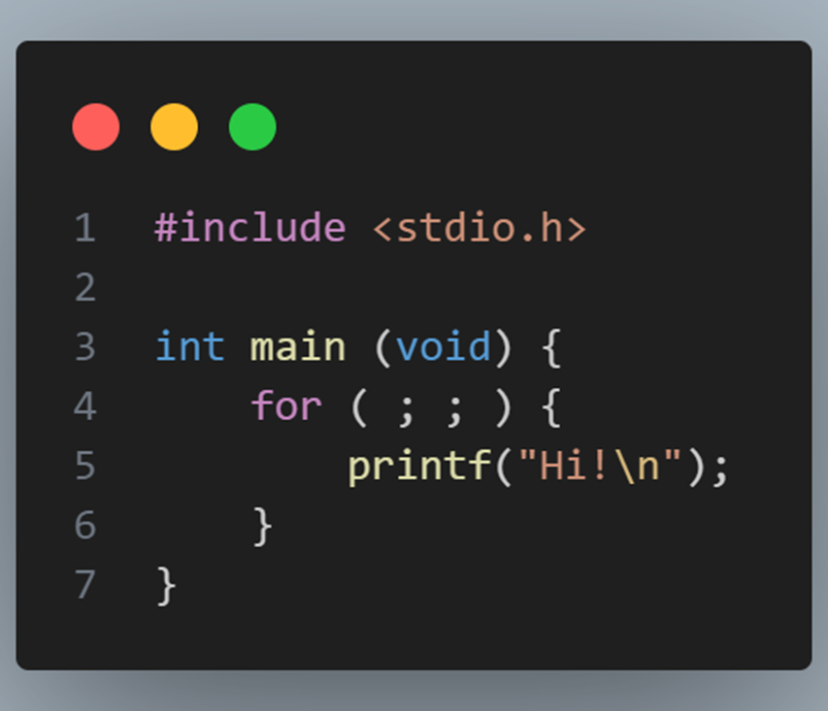
Puzzles from last time
Puzzles

Slide 3
cs50 section 2
Arrays!
Andrew Holmes, Fall 2023

Slide 5
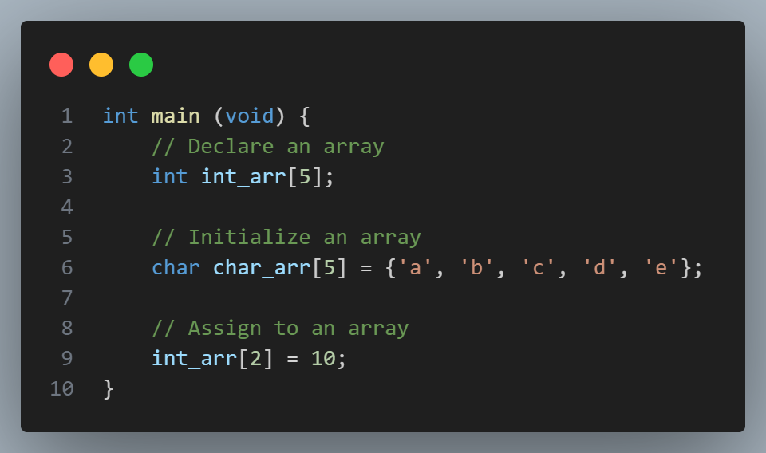
Arrays
Arrays

Slide 6
Functions

